Slide 1

EzCARS
Car Rental Application
TEAM 1:
Tarjanee Desai | Harsh Patel | Charitha Gangaraju | Bhavin Goswami | Jitendra Rawat | Prithvi Karkera
| Avinash Bhavancheekar | Krupali Dangshiya | Shaik Sameera | Chandraharsha Kosuri

Slide 2

Agenda
GitHub
Repo structure | Prerequisites | Installation
Code Snippets
Frontend | Backend
Deployment
Jenkins

Slide 3


Github URL:
https://github.com/CS691-CRN73915-Team1-EZCars

Slide 4

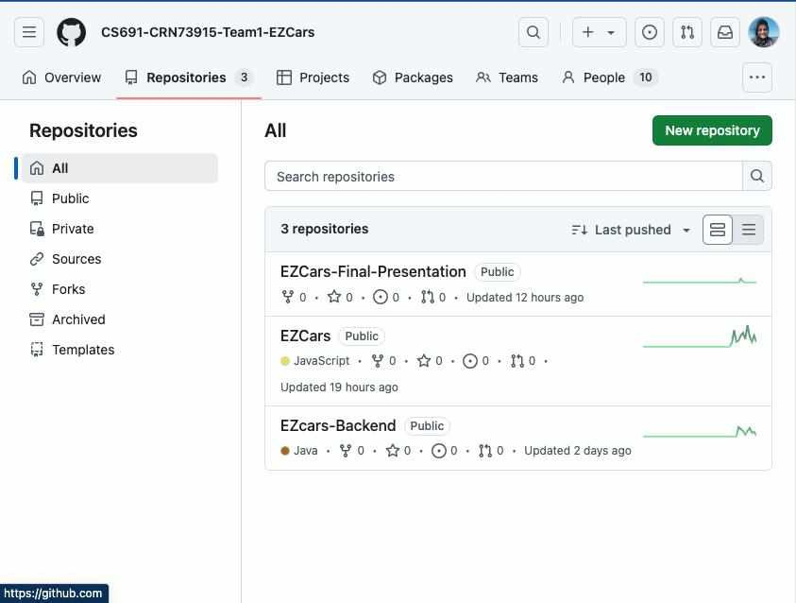
Repo Structure
EZCars-Final-Presentation
Contains all the approved deliverables and final documents
EZCars
Frontend - client repo
EZCars-Backend
Backend - server repo

Slide 5

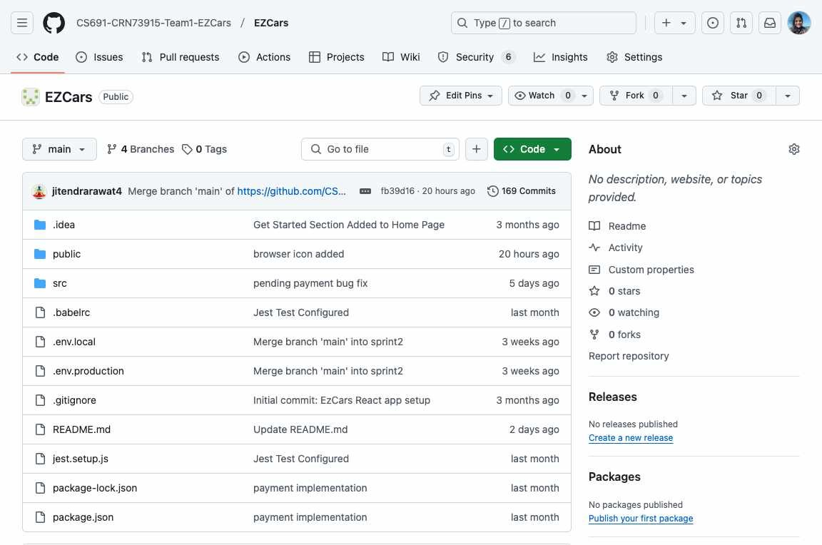
Repo Structure (Client - Frontend)

Slide 6
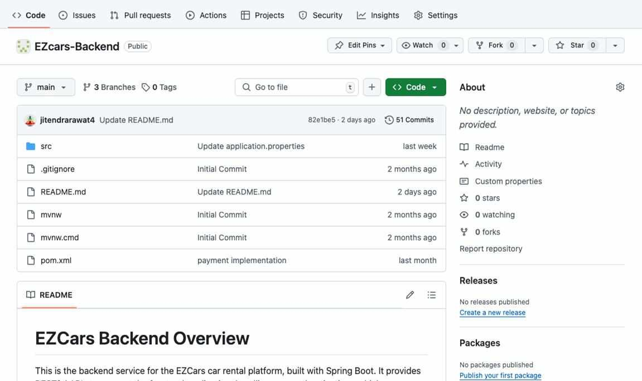
Repo Structure (Server - Backend)

Slide 7
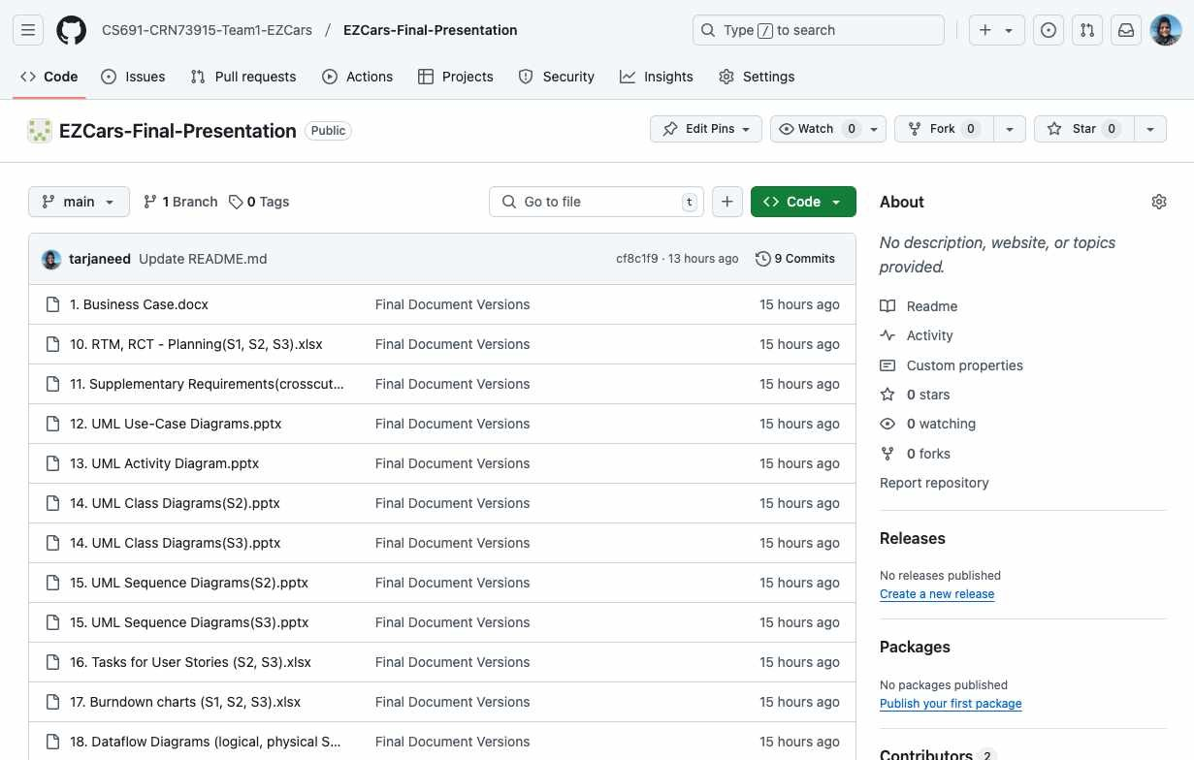
Repo Structure (Final Deliverables)

Slide 8





Prerequisite
MySQL Workbench JAVA
IDEs for Frontend and Backend Node.js

Slide 9




Installation guide
Backend folder
import pom.xml as maven project
and build the project.
change the credentials of the database server on according to the local machine.
Application Home
at localhost:3000, you will land on the homepage of EZCars.
Navigate through the application
and its features.
Clone the Repo
git clone <url>
Frontend folder
run the command [ npm install ]
and then [ npm start ]

Slide 10


Code Snippets

Slide 11
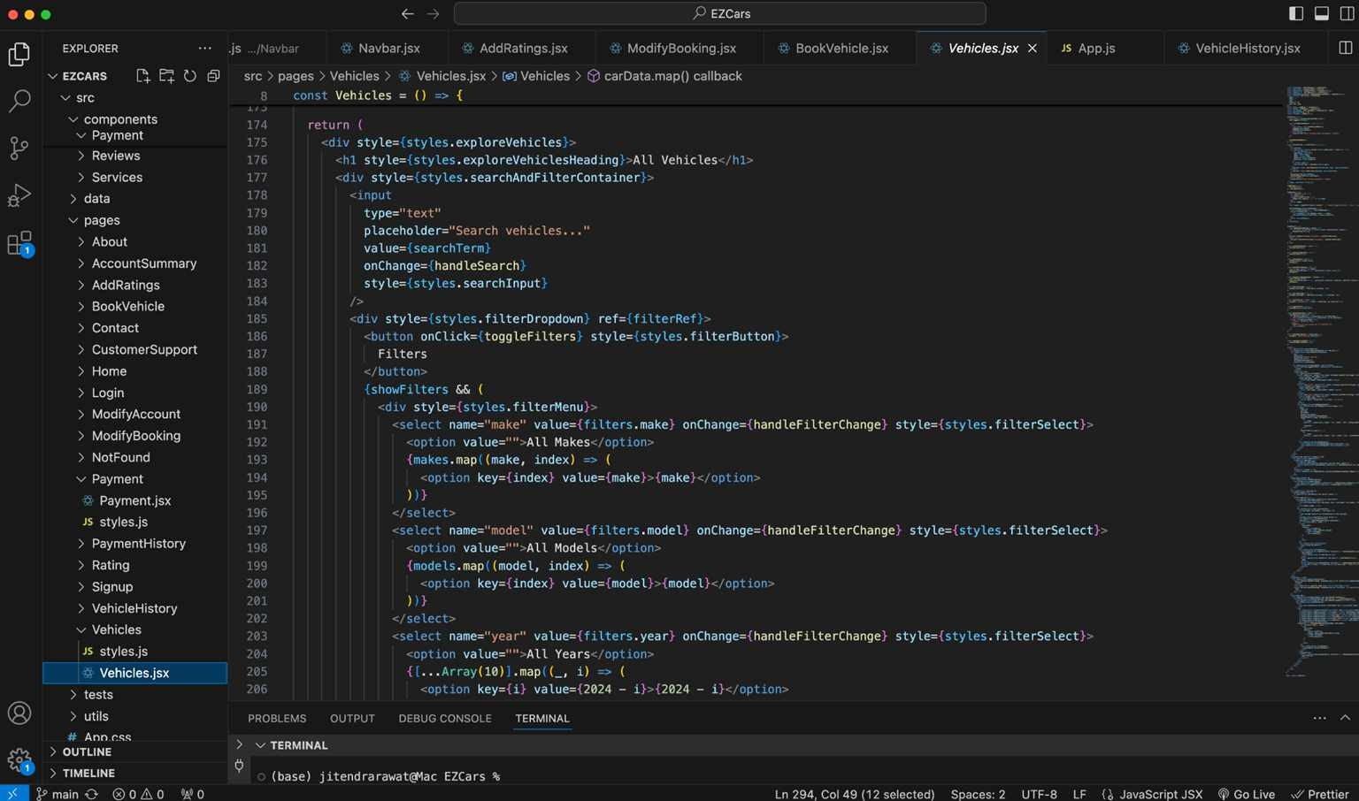
Vehicles (Listing of Vehicles-Frontend)

Slide 12
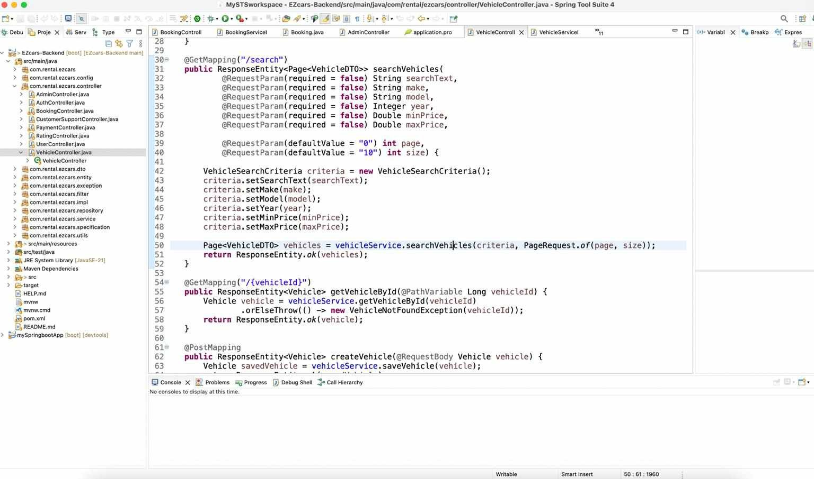
Vehicles (Backend)

Slide 13
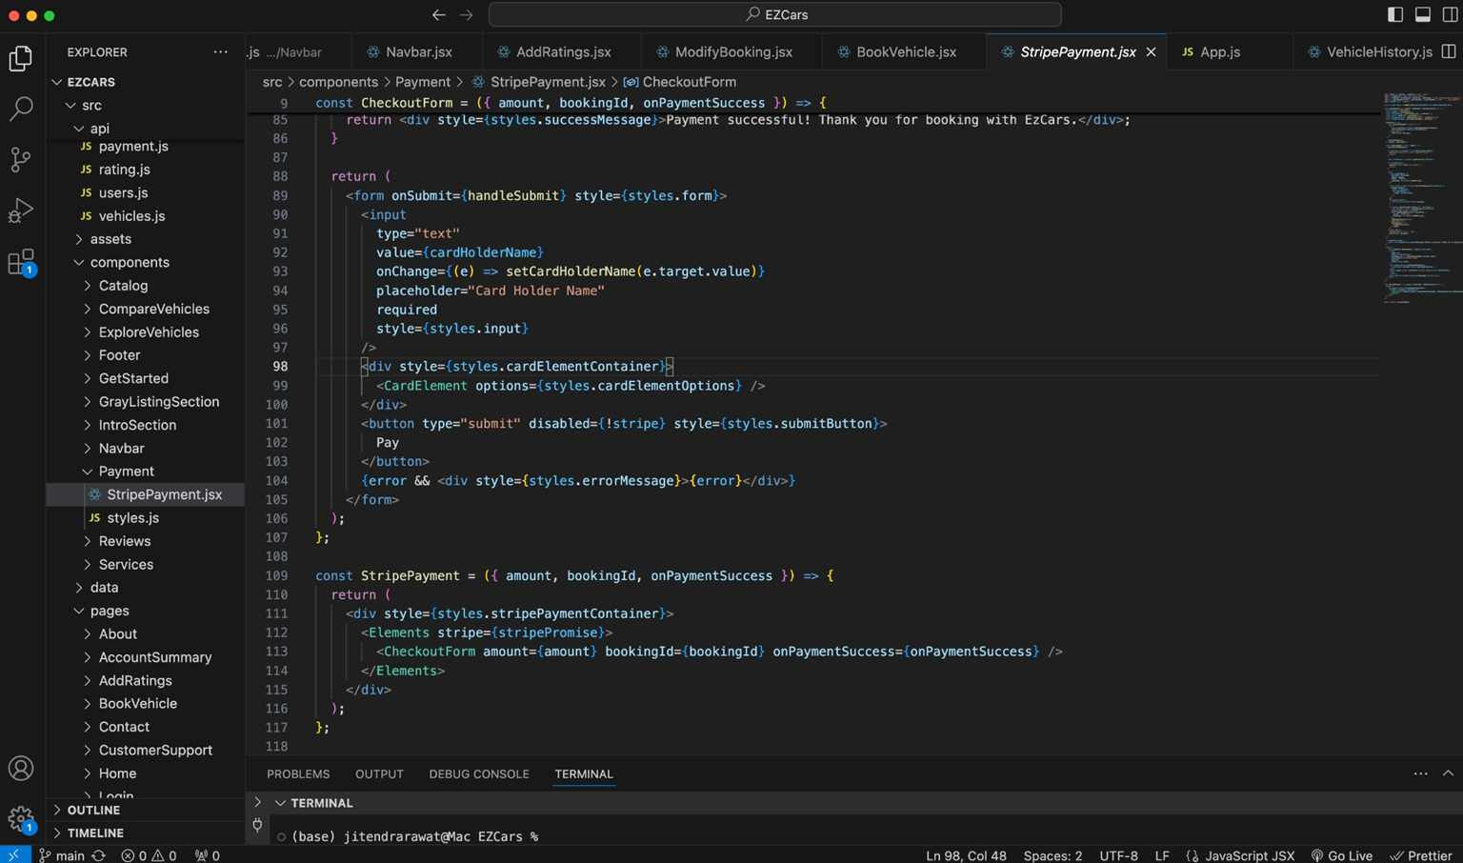
Stripe Payment (Frontend)

Slide 14
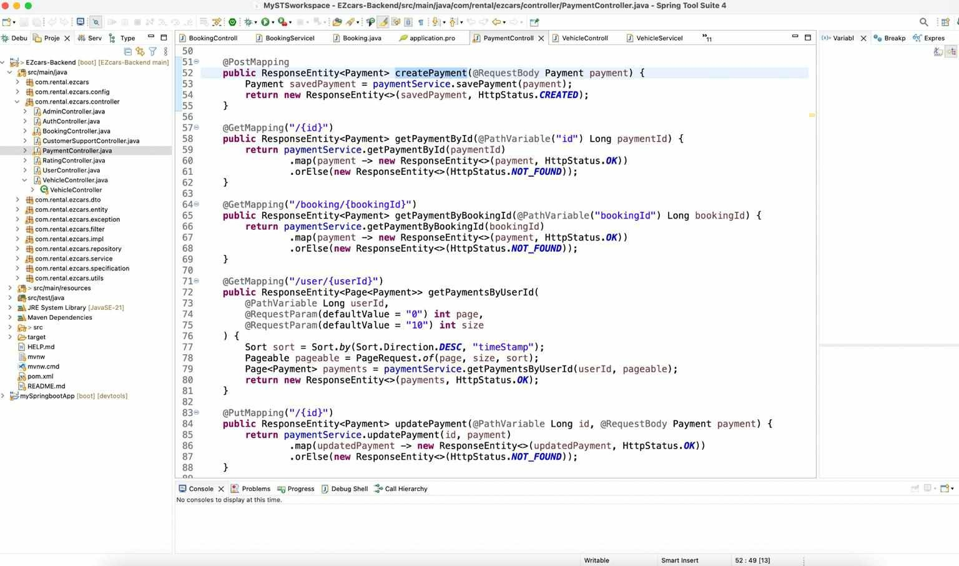
Stripe Payment (Backend)

Slide 15
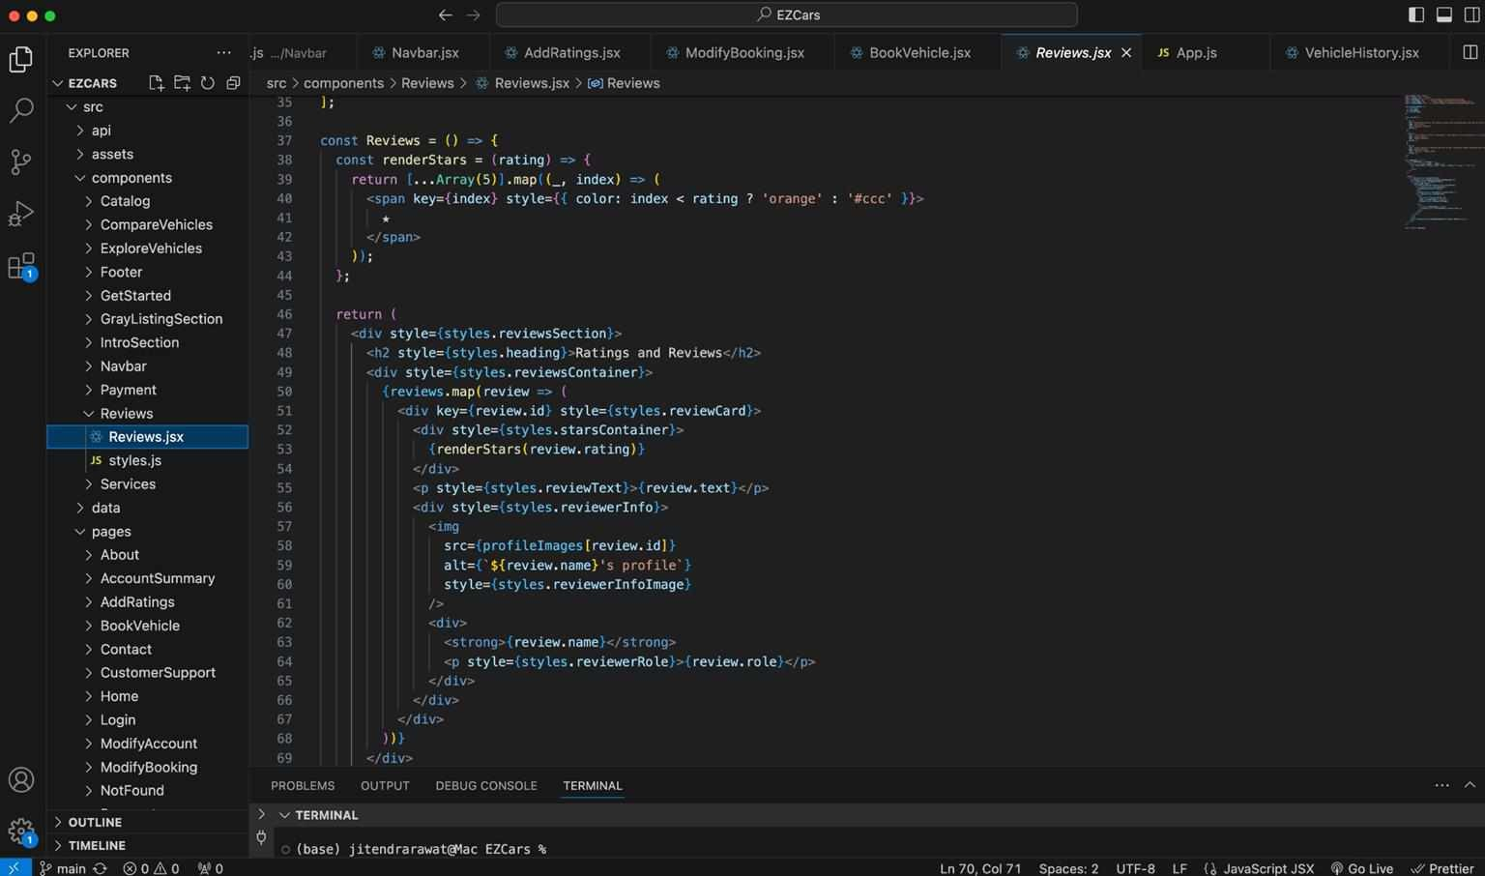
Reviews (Vehicle Reviews-Frontend)

Slide 16
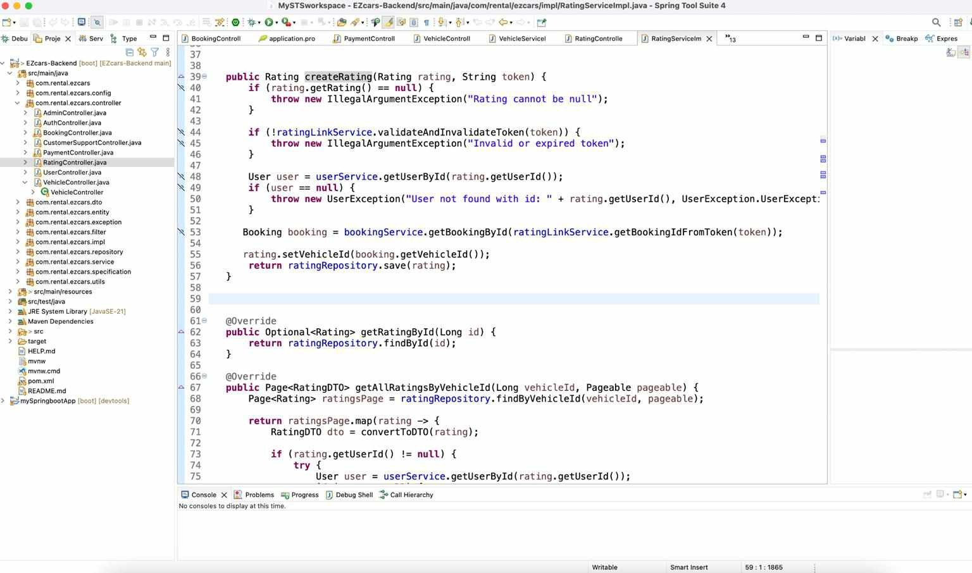
Reviews (Vehicle Reviews-Backend)

Slide 17
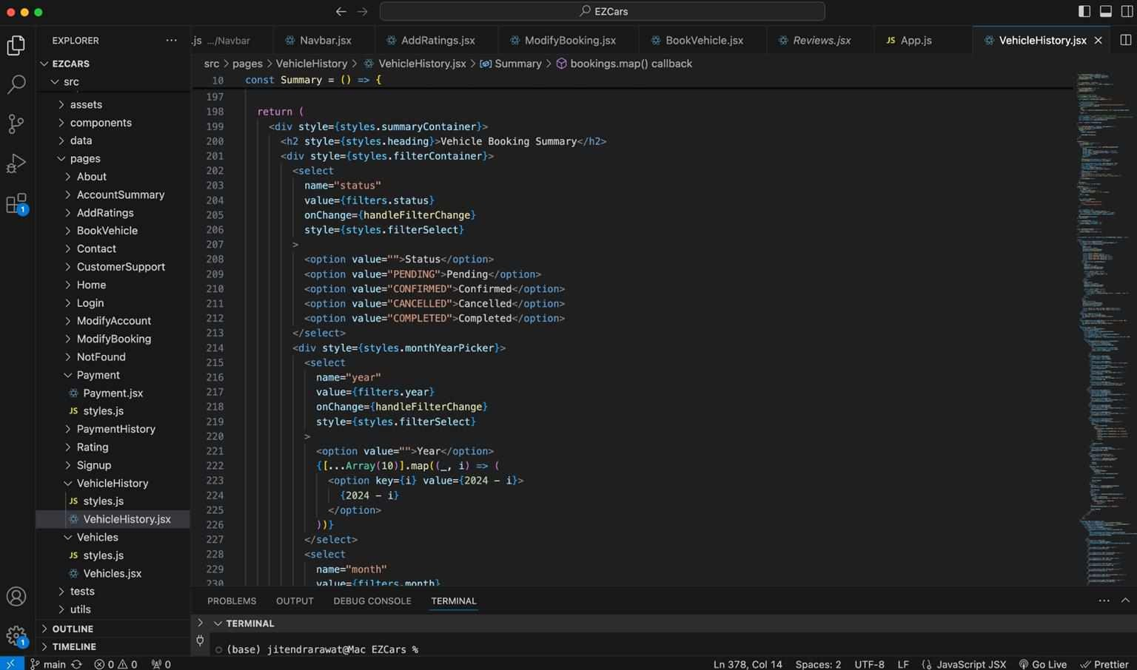
Vehicle History (Users Vehicle History-Frontend)

Slide 18
Deployment

Slide 19

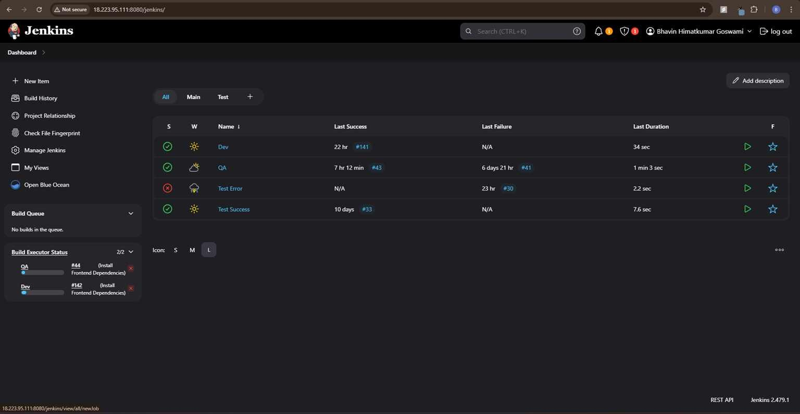
Jenkins Dashboard

Slide 20
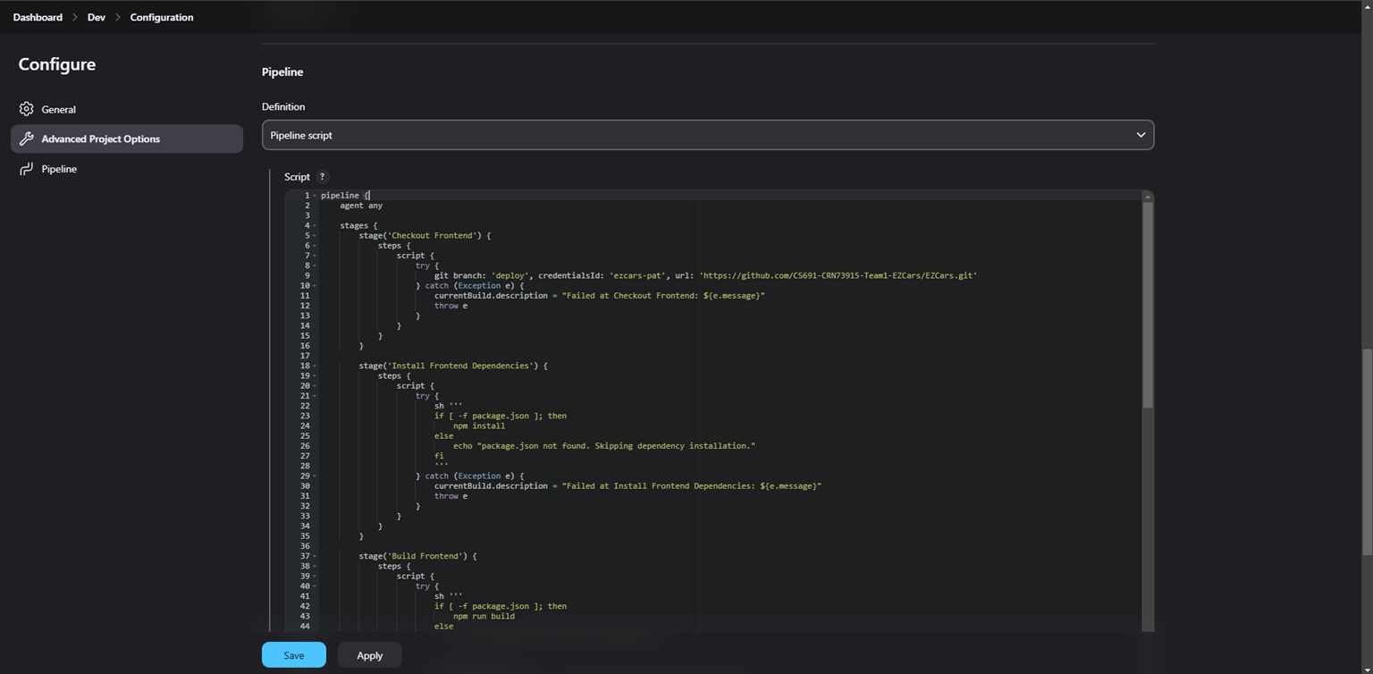
Pipeline

Slide 21
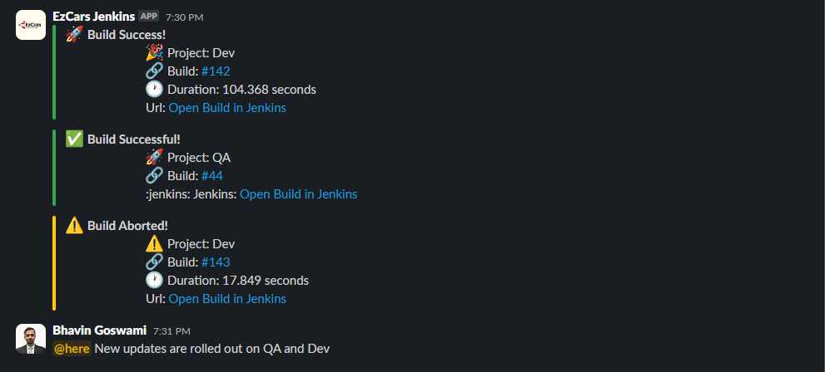
Slack Notification

Slide 22
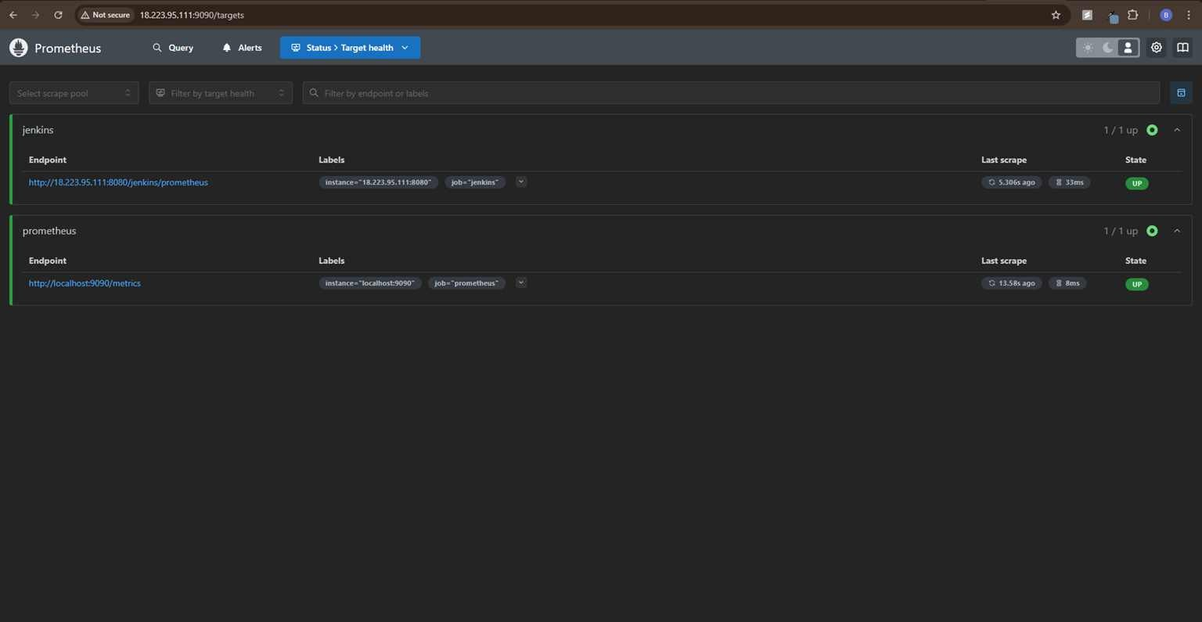
Prometheus

Slide 23
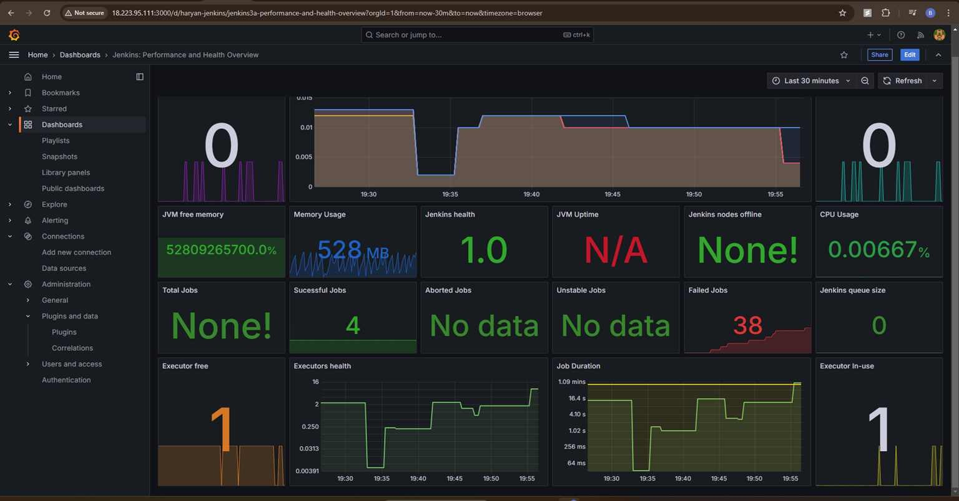
Grafana Dashboard

Slide 24
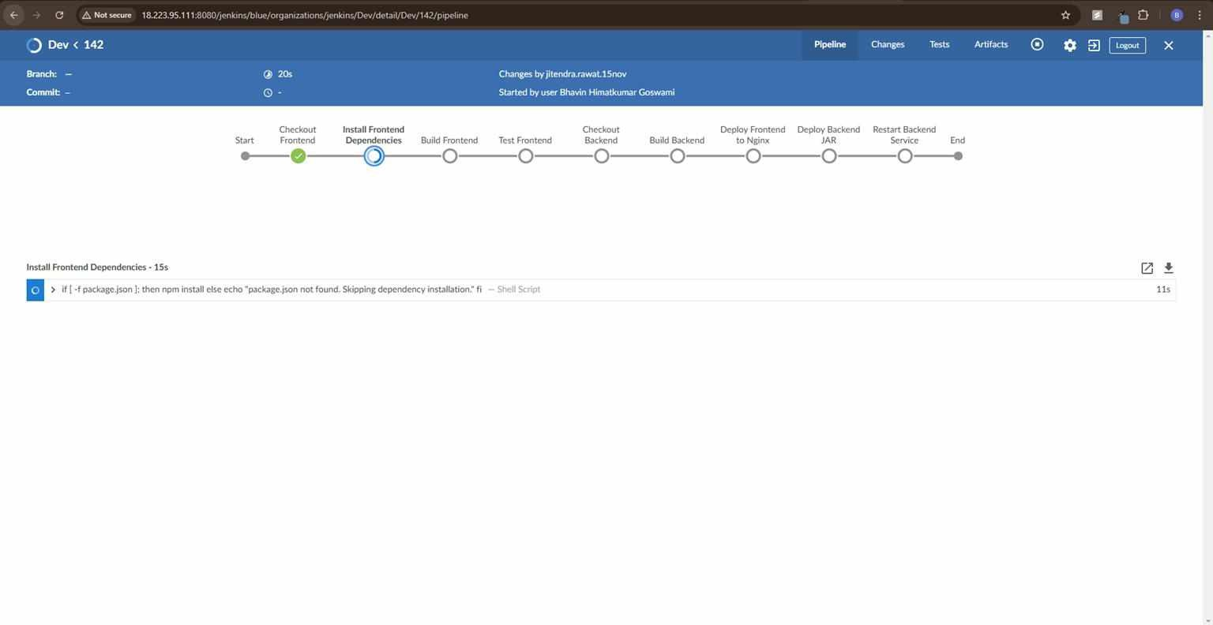
Blue Ocean Plugin

Slide 25

THANK YOU !

